Slide 1
Advanced Classification
DATA 6545: Data Science and MLOps
Dr. Jie Tao
Fairfield University

Slide 2
Support vector machines
SVMs introduces in COLT-92 by Boser, Guyon & Vapnik.
Development from Statistical Learning Theory in the 1960s – became rather popular since.
Empirically good performance:
Bioinformatics
Text mining
Image recognition

Slide 3
Strengths of SVMs
Good generalization
In theory
In practice
Works well with few training instances
Find globally best model
Efficient algorithms
Amenable to the kernel trick

Slide 4
SVM - overview
Basic Idea
Optimal hyperplane for linearly separable patterns
Extend to patterns that are not linearly separable by
transformation of original data to map into new space
kernel trick
SVM usually used for pattern recognition

Slide 5

SVM - motivation
We have 50 images of dragons and 50 images of phoenix
We convert them into 100 x 100 images, so we have a data set of 10,000 features for each image
Given a new image, how do we know is it a dragon or phoenix?

Slide 6
What are support vectors?
Support vectors are the data points that lie closest to the decision surface
Most difficult to classify
They have direct bearing on optimum location of the decision surface
We need to identify the optimal hyperplane from the function class with the lowest distance from the decision surface

Slide 7
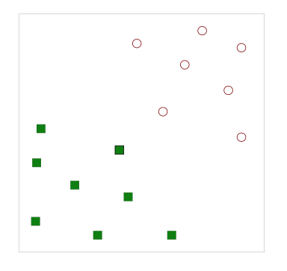
What’s hyperplane, then?
A hyperplane is the linear boundary that separates the data
Suppose you have some data or 2-classes
Can you find a hyperplane?

Slide 8
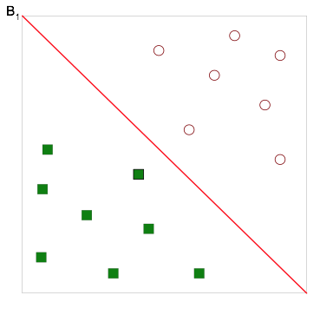
What’s hyperplane, then?
A hyperplane is the linear boundary that separates the data
Suppose you have some data or 2-classes
Sure we can!
But is that all?

Slide 9
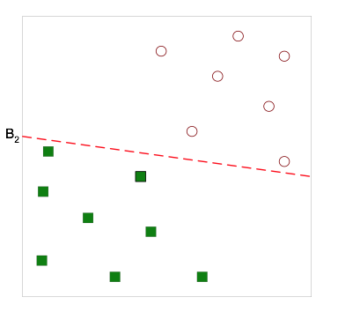
What’s hyperplane, then?
A hyperplane is the linear boundary that separates the data
Suppose you have some data or 2-classes
Sure we can!
But is that all?
Certainly not!

Slide 10
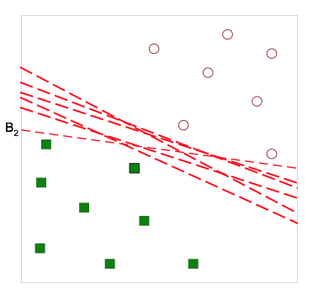
What’s hyperplane, then?
A hyperplane is the linear boundary that separates the data
Suppose you have some data or 2-classes
Sure we can!
But is that all?
Certainly not!
I can draw a lot HYPERPLANES!
But which one is the BEST?

Slide 11
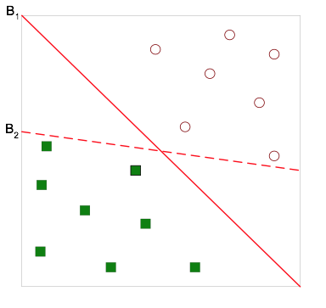
What’s hyperplane, then?
A hyperplane is the linear boundary that separates the data
Suppose you have some data or 2-classes
Let’s simplify things...
Which one is better, B1 or B2?
But what do you mean by BETTER?

Slide 12
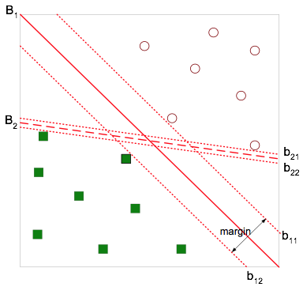
What’s hyperplane, then?
A hyperplane is the linear boundary that separates the data
Suppose you have some data or 2-classes
Let’s simplify things...
Which one is better, B1 or B2?
But what do you mean by BETTER?
The best hyperplane maximizes margin
So B1 is BETTER than B2

Slide 13
Why maximizes margin, then?
Increasing margin reduces capacity
i.e., fewer possible models
Lesson from Learning Theory:
low training error is likely to be evidence of low generalization error
In other words, you are training a stronger model

Slide 14
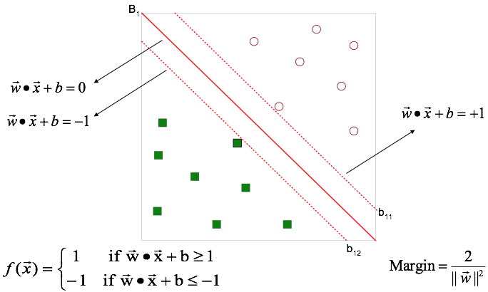
SVM Classifier
Now we know hyperplanes are decision boundaries, how do we make decisions using them?
Neural Nets use a similar function f

Slide 15
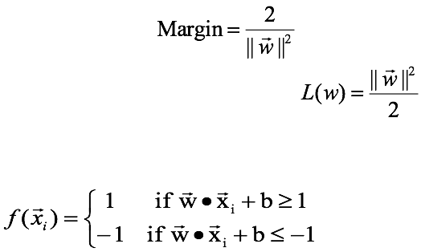
What’s Under the hood...
We want to maximize:
Which is equivalent to minimizing:
But subjected to the following constraints:
This is a constrained optimization problem
Numerical approaches to solve it (e.g., quadratic programming)

Slide 16
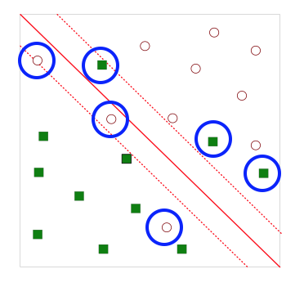


What if the problem is not linear separable?
Points in blue circles are classified wrong
We cannot find a linear hyperplane, or can we?
Introduce slack variables
Need to minimize:
Subject to:
Slack variables is the resistance of errors

Slide 17
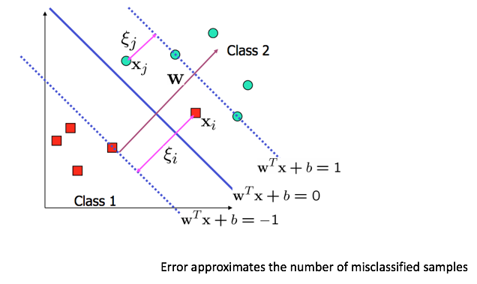
Slack variables allows errors
But till now SVMs function like multiple logistic regression models…
That’s not all for SVMs.

Slide 18
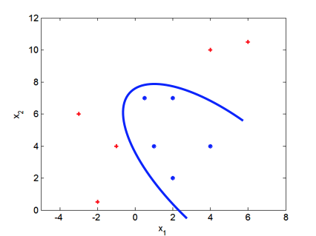
Non-linear SVMs
We can use a non-linear boundary if the problem is not linear separable

Slide 19
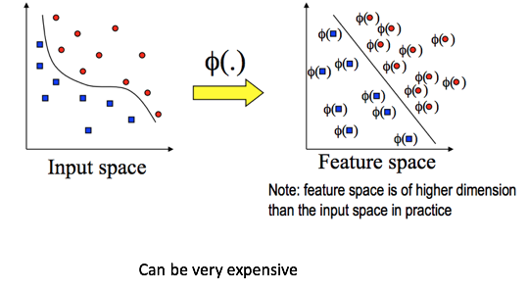
Wait… but how?
We can transform data into a higher dimensional space

Slide 20
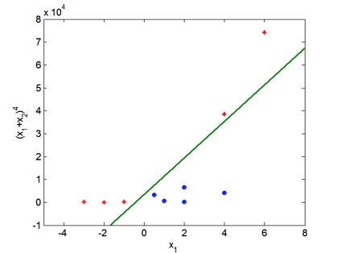
So we can do this...

Slide 21
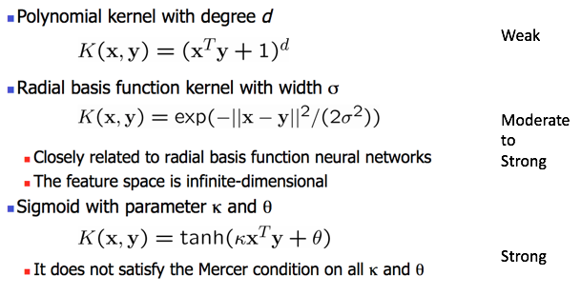
Non-linear SVM Kernels

Slide 22
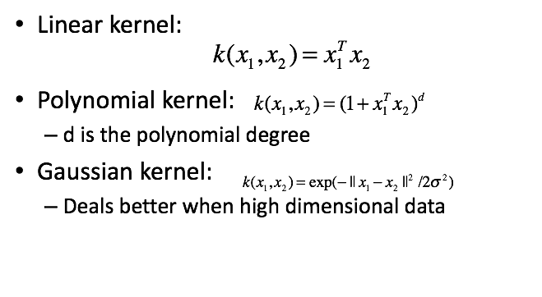
Example of kernels

Slide 23
The “kernel trick”
Takes input data and transform it
Explicify some “hidden” boundaries that cannot be observed directly
The core of SVM algorithm is to identify the most optimal hyperplane

Slide 24
Choosing the kernel function
Probably the most tricky part of using SVM.
The kernel function is important because it creates the kernel matrix, which summarizes all the data
In practice, a low degree (<5) polynomial kernel or RBF kernel with a reasonable width is a good initial try
Note that SVM with RBF kernel is closely related to RBF neural networks, with the centers of the radial basis functions automatically chosen for SVM
Usually done in trial-and-error

Slide 25
Other aspects of SVM
Using SVM for multi-class classification
SVM are originally designed for binary classification
Create “dummies” for multi-class target, then train multiple binary classifiers – then combine them
How to interpret SVM results, for both classification and regression?
By performing logistic regression on the SVM output of a set of data (validation set) that is not used for training

Slide 26
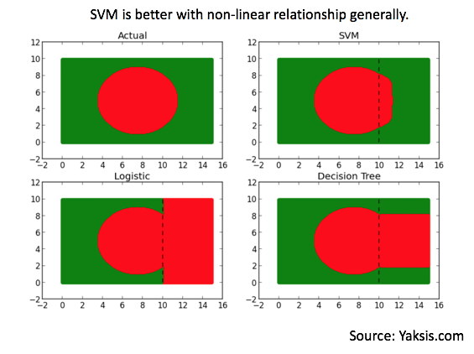
SVM vs. other classifiers

Slide 27
Svm - pros & cons
Pros
Usually best classification performance
Fast (construction and interference)
Scalable learning
Can deal with all kinds of inputs (continuous, categorical, series/sequences, tree)
Cons
Black-box learning
Not so applicable to discrete inputs
Need to specify the kernel function (not out-of-box)
Issues with multiple classes

Slide 28
Ensemble Learning
Ensemble learning refers to algorithms that combine the predictions from two or more models.
Based on popularity, there are mainly three types of ensemble methods:
Bagging
Stacking
Boosting

Slide 29
Bagging Ensemble Learning
Train multiple weak learner (typically an unpruned DT)
Of the same learning algorithm
On different subsets of the training set
Note that the subsets don’t have to disjoint - that’s different from CV
The results from the weak learners are combined using simple statistical methods
Voting (e.g., majority vote)
Averaging
Typical algorithms (supported by sklearn）
Extra tree
Random forest
Canonical tree

Slide 30
Stacking Ensemble Learning
Train member models (typically using multiple fast algorithms, Regression, DT, NB, …)
On the whole of training data
Then train a meta-model using the results from the member models as inputs
Instead of relying on voting or averaging
If using linear/logistic regression → similar as weighted average
But we can use non-linear models
Bagging attempts cancel out the bias from your training data, while stacking attempts to cancel out bias from different algorithms

Slide 31
Boosting Ensemble Learning
Changing focus to correctly classified samples (in the training set)
Train weak learners (DTs) using a small subset
Weighted voting or averaging to combine results
Weights are the performance of the weak learners
If a learner perform well, more weight assigned to it
Bias toward hard to predict samples
Iteratively add ensemble members to correct predictions of prior models.
Combine predictions using a weighted average of models.
Typically AdaBoost and XGBoost

Slide 32
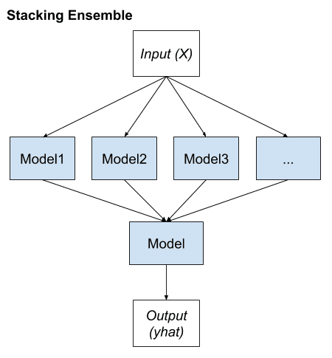
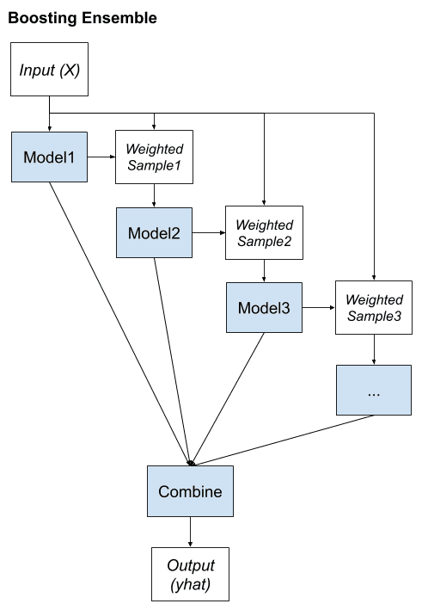
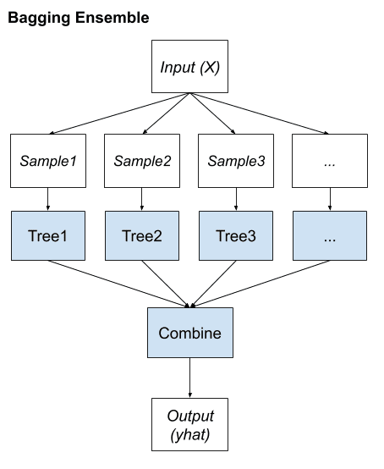

Slide 33
Now let’s see some
SVM & XGBoost
in action!

